Slide 1

Disclaimer: I added more plots to what I have done previously.
Since this was a personal project, I decided to consider that students are my audience.

Slide 2



Outline
Is the Pokémon Company getting lazier?
How can I build my dream team?
What is the best starter?

Slide 3
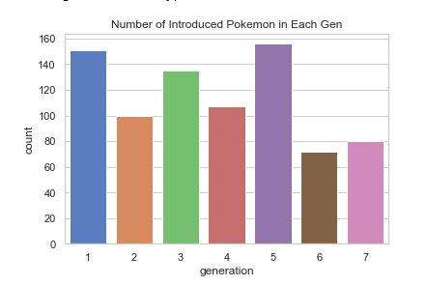
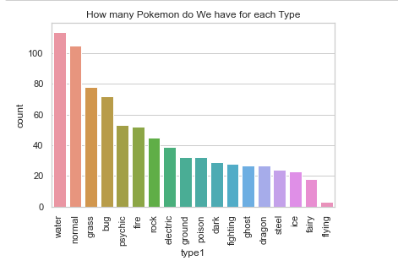
Is the Pokemon Company getting lazier?

Slide 4
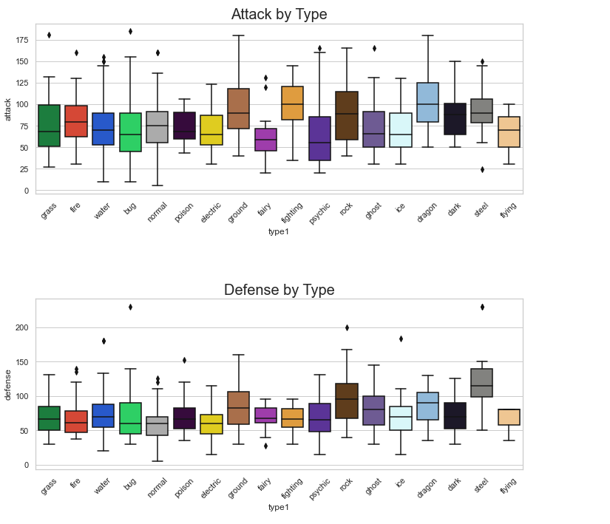
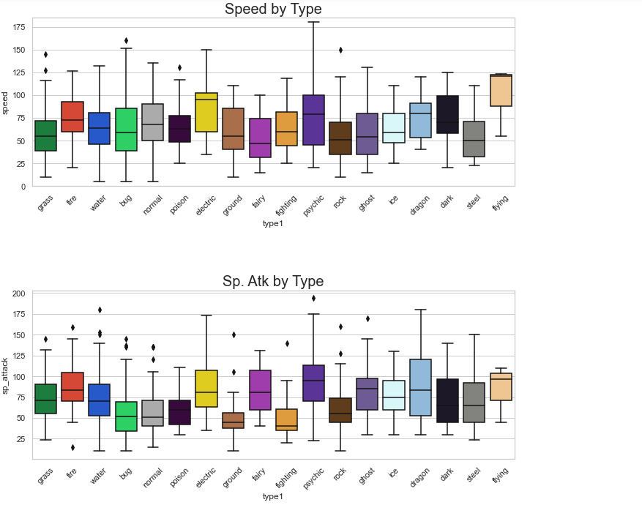
2) How Can I build my dream team?

Slide 5
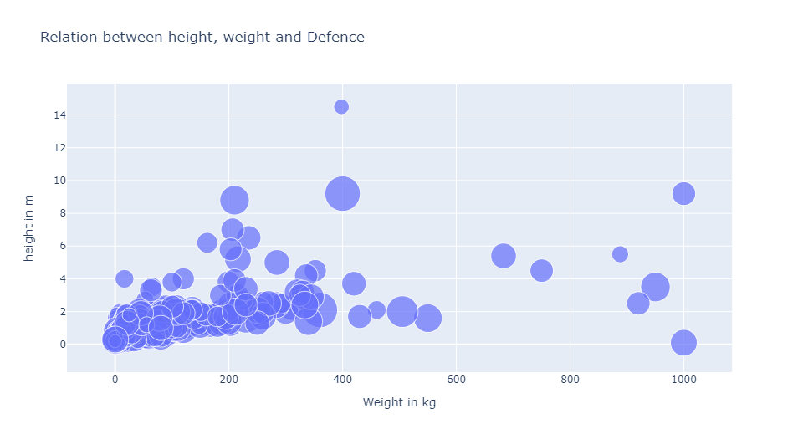
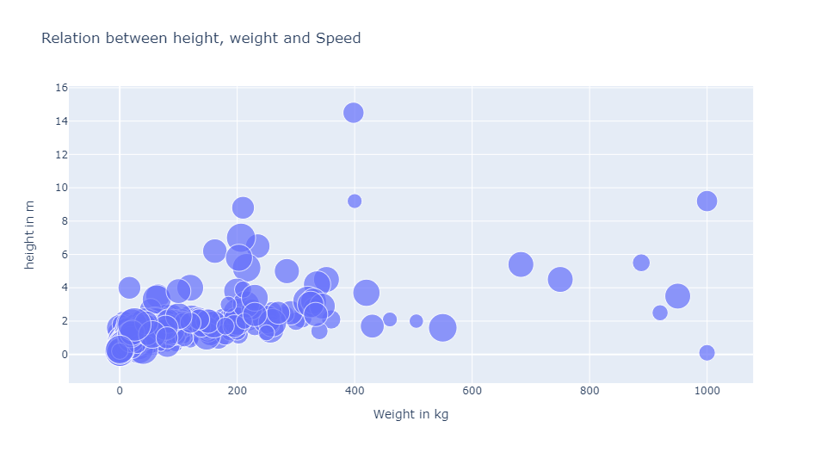
2) How Can I build my dream team?

Slide 6
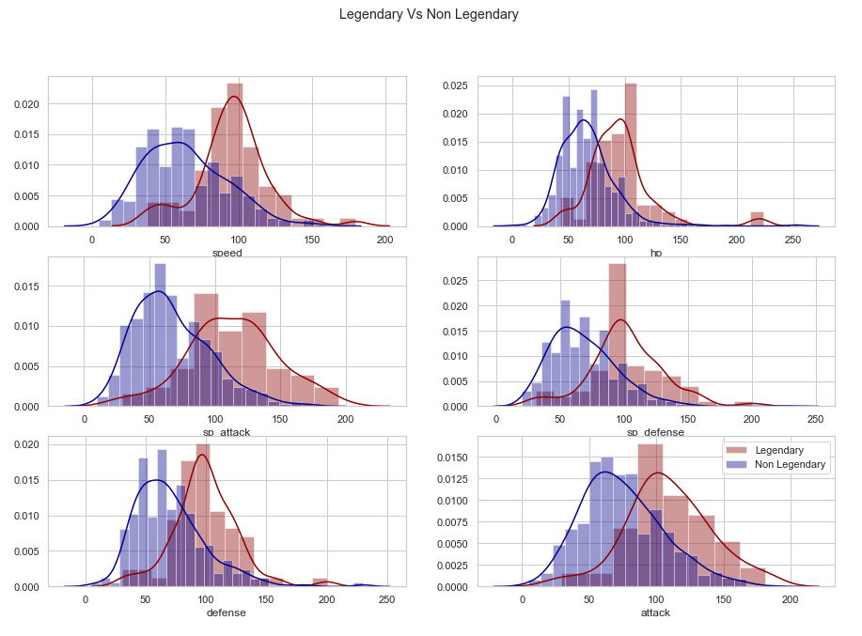
2) How Can I build my dream team?

Slide 7
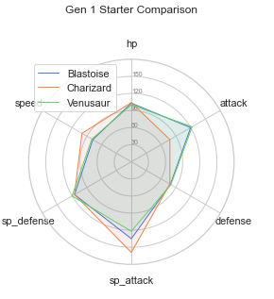
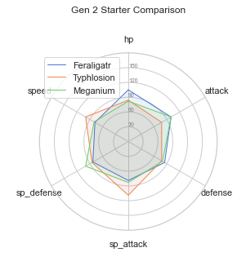
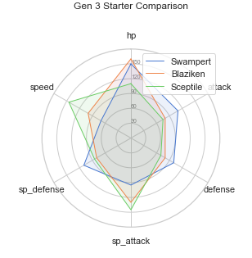
3) What is the best starter?

Slide 8
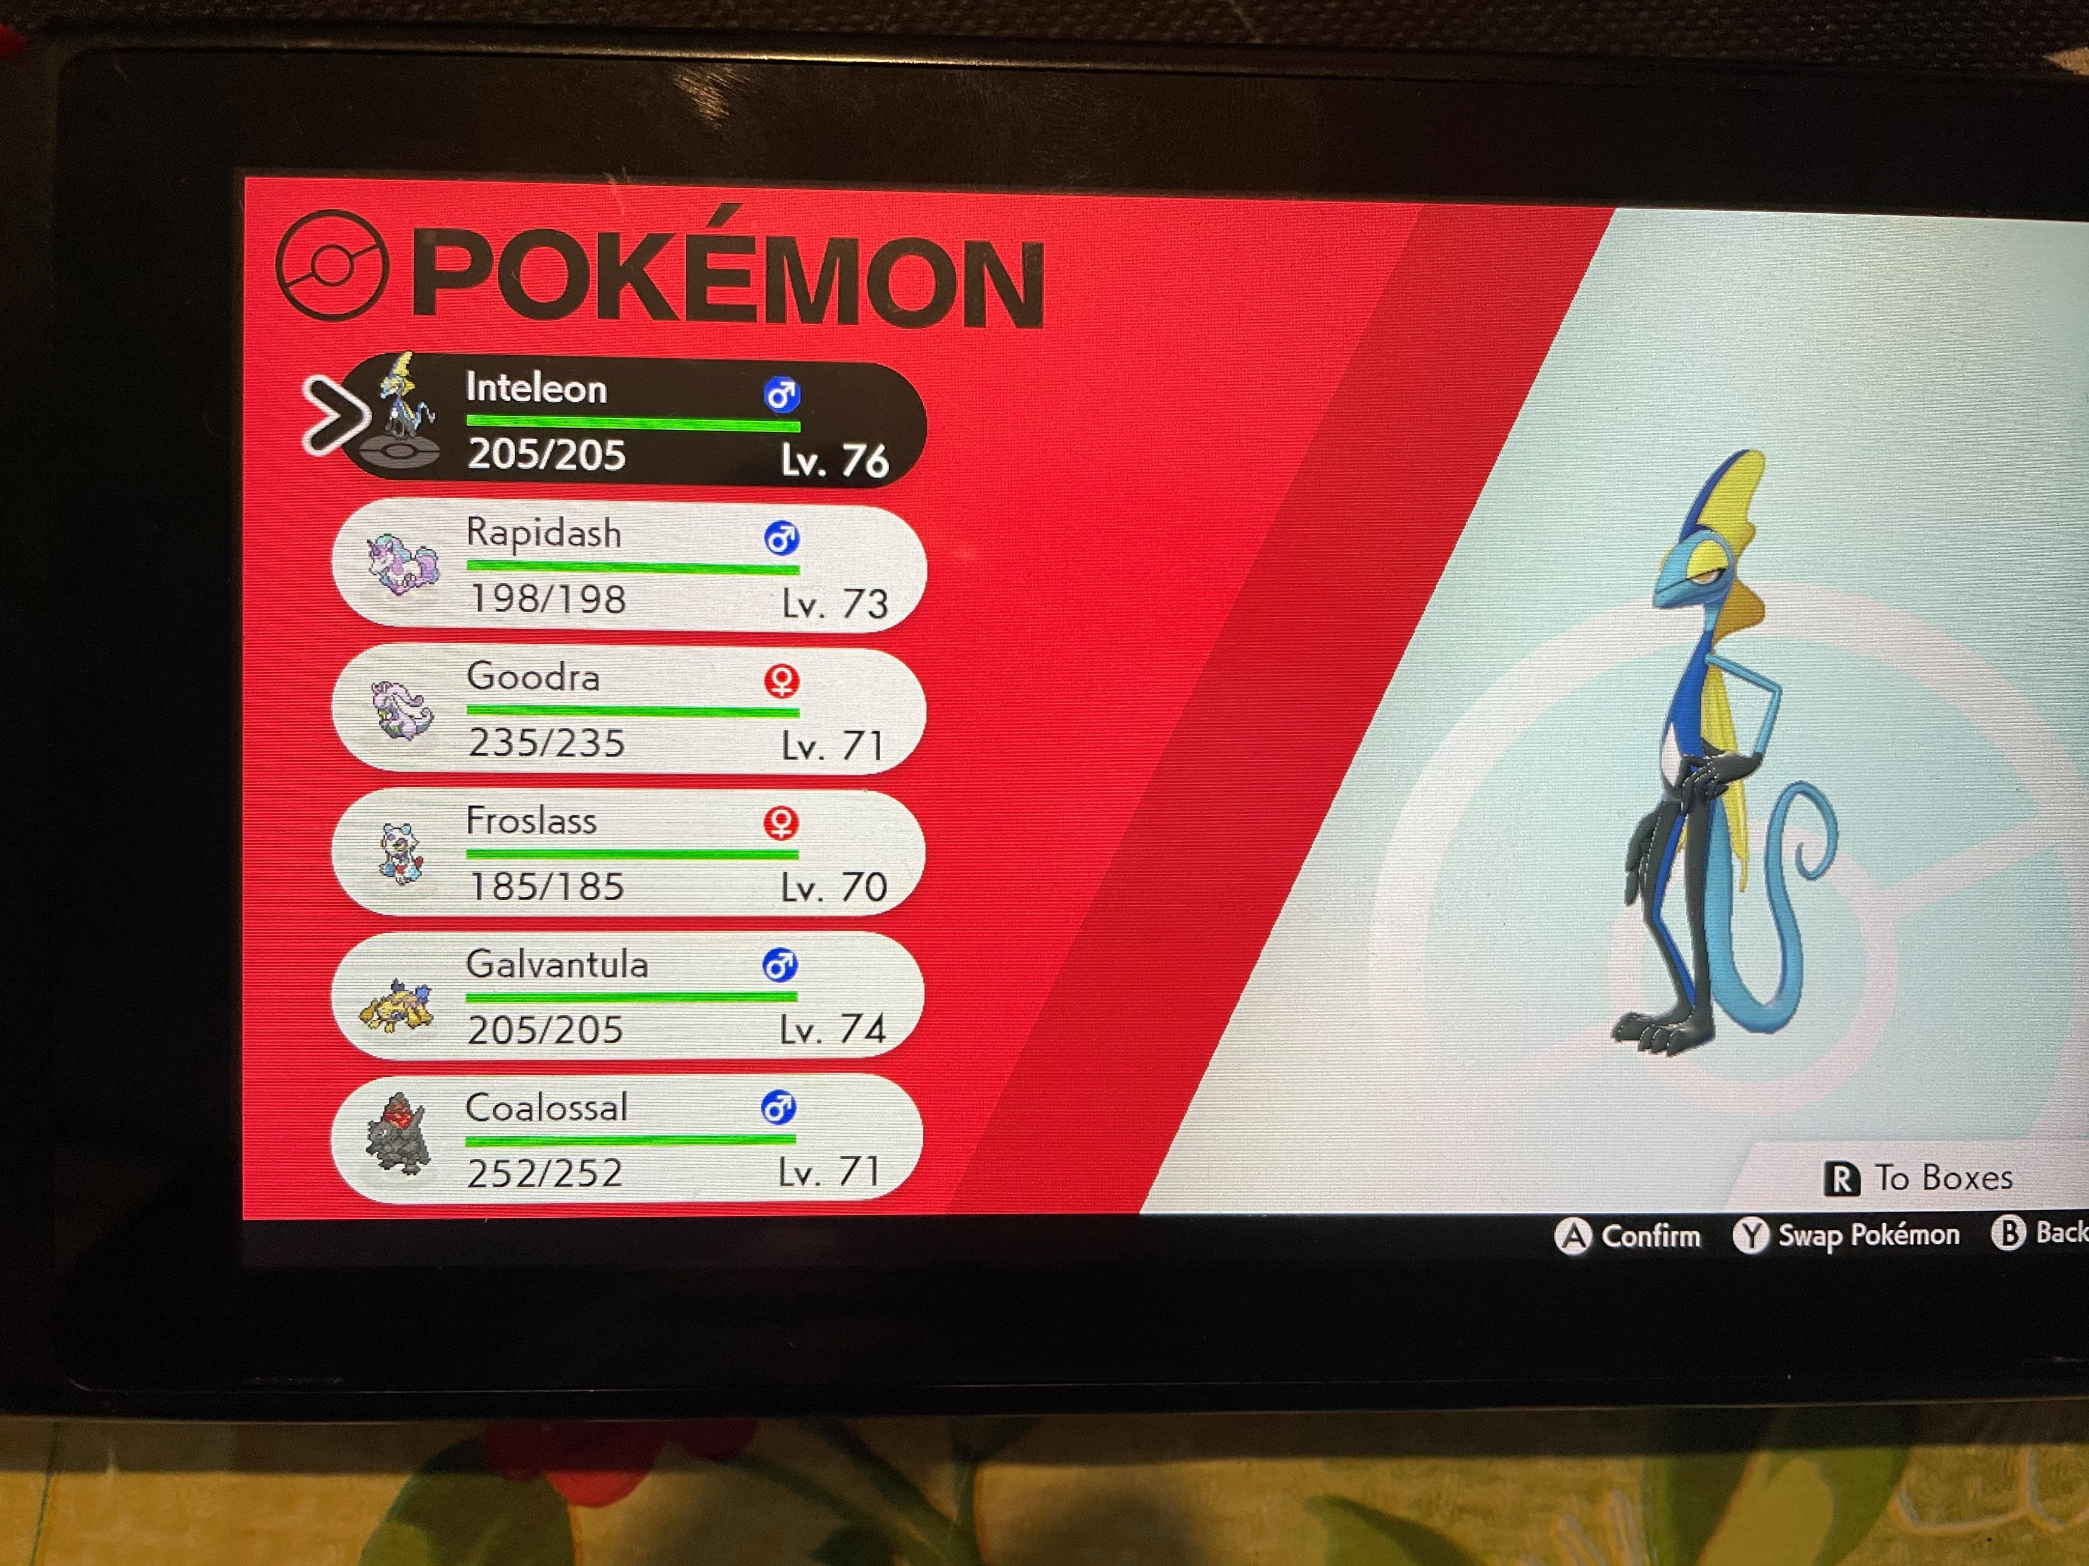
4) It Worked with me, so why not with everyone else?

Slide 9
Recommendations:
It is obvious that Pokemon are getting lazier and they should act upon this by introducing new Pokémon.
People looking to build a team should focus on their typing, as they have a strong relation with the stats. For instance, if someone wants a Pokémon with strong speed stats, he should catch an electric Pokémon.
People should not refer to the weight of a Pokémon to determine its stats, as we proved that they are not really logical.
Legendary Pokémon are overpowered Pokémon and the player should definitely catch them. However they are pretty rare and can only be caught in the endgame.
The Radar plot should be used to help the player choose their started. For instance, in gen 1, people might choose Charizard for his speed and special attack.

